Slide 1
EE2211 Python Tutorial
Xingyi Yang
xyang@u.nus.edu
Jan 13 2023
Notes:
Because for most of the time, talking about programming language is boring. I would like to bring some fun facts about python during this course. You may type your questions in the chat box anytime during the tutorial. You can also share your screen to ask for my help on programming part.

Slide 2
20 min
20 min
20 min
Introduction
Environment Installation
on my computer
Q&A

Slide 3
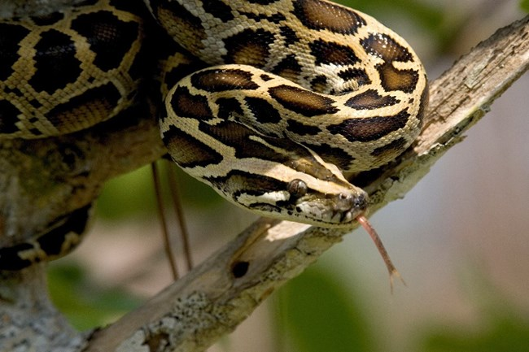
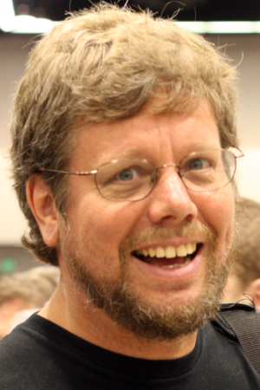
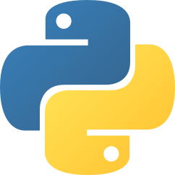
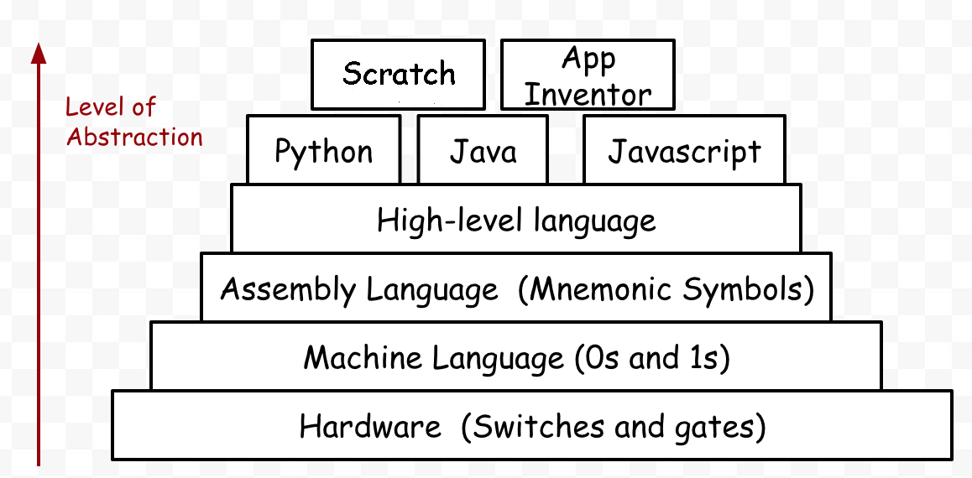
Python was conceived in the late 1980s by Guido van Rossum from Nederland
The programming language's name 'Python' came from a BBC Comedy series in the 1970's named Monty Python's Flying Circus. The author thought he needed a name that was short, unique and slightly mysterious.
Short and Simple

Slide 4
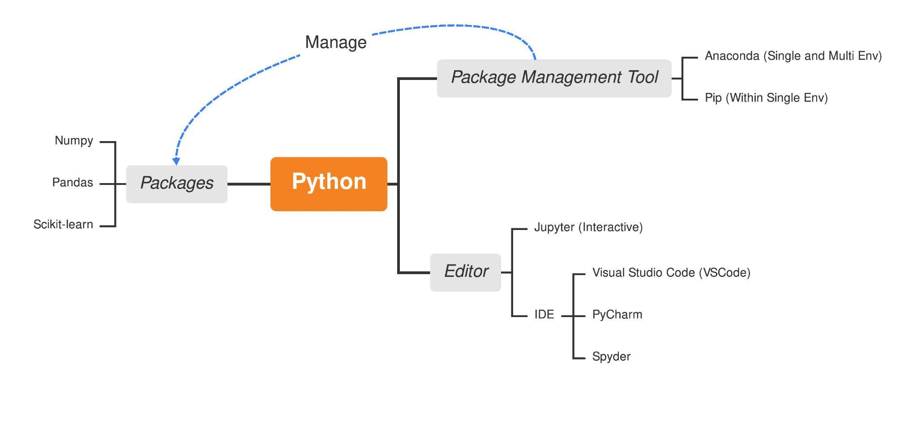
What we will talk about in two weeks
Notes:
1 hours 3 parts. 20 min for installation and setup the environment 20 min for packages/python basics and 20 min for numpy

Slide 5
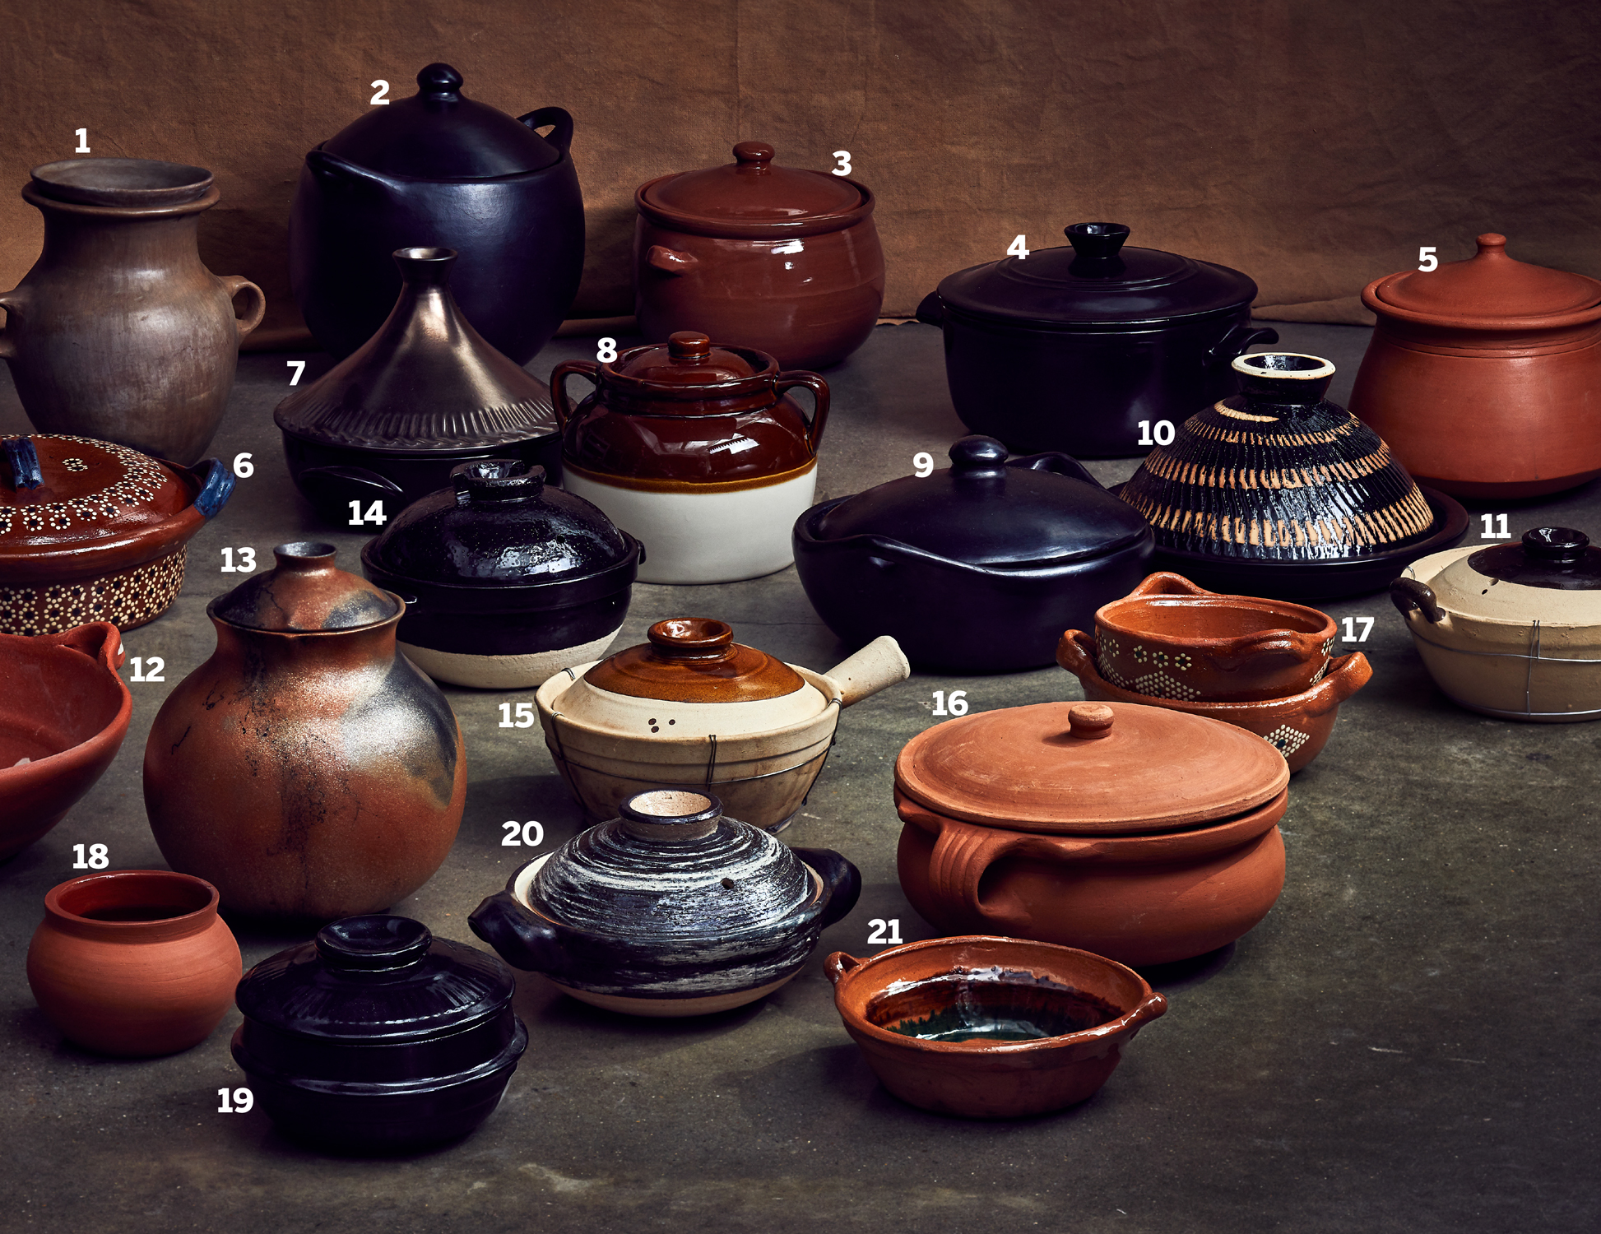

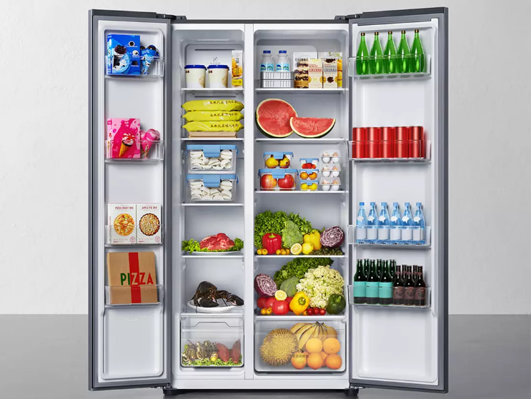


Package management Tool
Editors
Python
Packages
Your Program

Slide 6
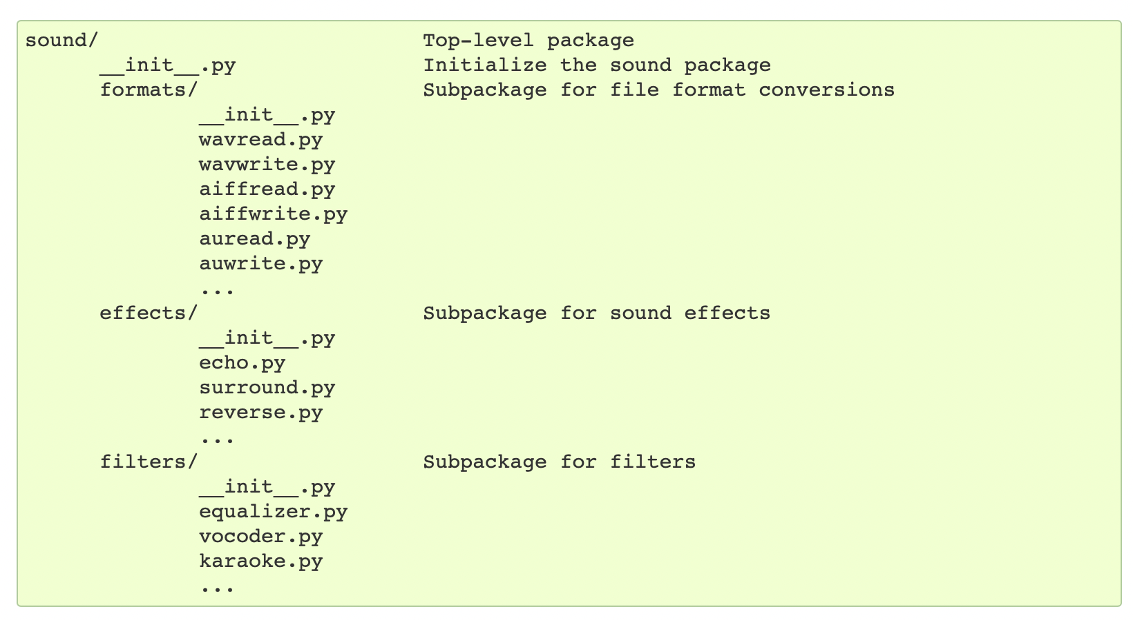
Import package and module
Module is a script contains code, and we can import
Package is a collection of modules
import sound.effects.echo
import sound.effects.surround
from sound.effects import *

Slide 7
Install Anaconda & How to use it
I personally recommend to use mini-conda (lite version of anaconda)
https://docs.conda.io/en/latest/miniconda.html
Of course you can also install the full version on
https://www.anaconda.com/
If you have trouble installing them on your computer, You can use
https://colab.research.google.com
Notes:
Some of the lectures will teach you to look at the panel in anaconda. Actually, there is no need to look at the visualization panel during coding.

Slide 8
Create the environment
conda create --name ee2211 python=3.7 numpy=1.20 matplotlib scikit-learn pandas
conda activate ee2211
conda list
conda install jupyterlab
Pip list & pip install XXX

Slide 9
Have your Editor ready
Integrated development environment(IDE): Vscode PyCharm
Interactive Editor: Jupyter (in browser)
Notes:
Recommended to use Vscode. Very light weight and extensibility.

Slide 10
Frequent Ask Question
1. On windows, install conda but can not call?
Add the conda into your PATH
2. Make sure install the package in the correct env!
Notes:
Recommended to use Vscode. Very light weight and extensibility.

